Slide 1
Airline Reservation System
Group Number 1:
Project Mentor: Yogini Naik
Notes:
Add instructor notes here.

Slide 2
Objectives
Project Understanding
Approach used
Project Execution
Modules
Learning
Best Practices
Opportunity for improvement
Demo and Code Walkthrough
Q&A
Notes:
Add instructor notes here.

Slide 3
Project Understanding
Aimed at developing an Airline Reservation System (ARS) for customers.
ARS is used to –
• Search flight details
• Reserve flight
• Update any reservation
• Cancel reservation
Notes:
Add instructor notes here.

Slide 4
Project Understanding
It is an integrated system
• User component
• Administration component.
Additional features like report generators.
Notes:
What has to be implemented,what did we learn,technologies learned
Add instructor notes here.

Slide 5
Approach used :
Business Logic Components and Services
    Java component classes
    Java Beans
    Spring with JPA
    JSP for web Application
Databases : Oracle
Notes:
Add the notes here.
Add instructor notes here.

Slide 6
Project Execution
Airline Reservation System is performed and executed in three
modules
  User
  Airline Executive
  Administrator
Notes:
Add the notes here.
Add instructor notes here.

Slide 7
Module - User
User should be able to
  User can search for multiple flights available as per his requirement on that particular day.
  Place a request for a flight ticket.
  User should be able to view the reservation details, update and cancel the booking.
Notes:
Add the notes here.
Add instructor notes here.

Slide 8
Modules – Airline Executive
The airline-executive should be able to :
• Login into the system using his/her credentials.
• View flight-occupancy details
      Based on the departure date and in a specified time interval.
      Based on the departure Location, departure date and in a specified time interval.

Slide 9
Module – Administrator
The administration should be able to
Login to the system using his/her credentials
Insert a new flight Details into Database.
Update and manage flight schedules
  Update Departure Date and Arrival Date.
  Update Departure Time and Arrival Time.

Slide 10
Module – Administrator
Update and manage flight information
  Update No: of First Seats and Business Seats.
  Update First Seat fare and Business Seats Fare.
Generate various reports like:
  View List of flights on a particular day, to a particular destination etc.
  View Bookings of specific flight.
  View passenger list of specific flight.

Slide 11
Learning
We learned how to integrate JPA with Spring.
We learned how to display web application using JSP along with Spring Framework.
We learned how to design
  Time Sheets
  Minutes Of Meeting
  Traceability Matrix
  Query Tracking Sheet
  LLD & HLD
Notes:
Add the notes here.
Add instructor notes here.

Slide 12
Learning
  We also learned how to design Test cases, Work break down Structure, Time Sheets, code review check list, UTP check list.
  We learned how to implement coding standards for
    java classes
    JSP pages
    Java Beans naming Convention.
Notes:
Add the notes here.
Add instructor notes here.

Slide 13
Best Practices
We followed Coding standards to ensure best practices which included
  Coding Standards to define class names and method names.
  Coding Standards to define JSP page names.
  Followed MVC architecture for web application to increase code readability and maintenance.
  Used code review check list, query tracking, traceability matrix to ensure that project meets specified requirements.
Notes:
Add the notes here.
Add instructor notes here.

Slide 14
Opportunity for improvement
We can integrate the application with Artificial intelligence, to increase users system interaction and to create user friendly Environment.
We can use dynamic memory management and memory optimization techniques in data base to increase memory utilization efficiency.
We can use cookies and we can suggest existing user with best offers available and flights based on his previous bookings.
Notes:
Add the notes here.
Add instructor notes here.

Slide 15

Demo and Code Walkthrough
Notes:
Add the notes here.
Add instructor notes here.

Slide 16
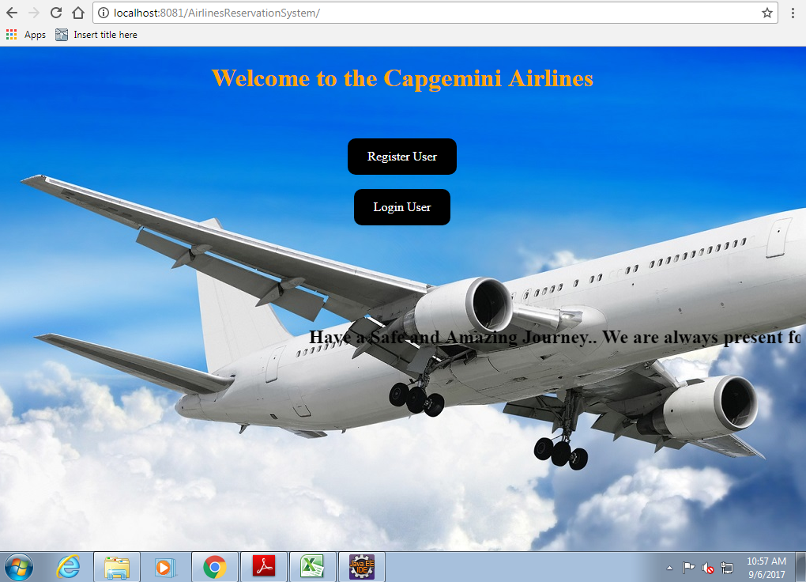
Home Page
Notes:
Add the notes here.
Add instructor notes here.

Slide 17
Q & A
Notes:
Add the notes here.
Add instructor notes here.

Slide 18
Thank You
Notes:
Add the notes here.
Add instructor notes here.

